Slide 1

Justin Cheng , Lada A. Adamic, P. Alex Dow, Jon Kleinberg, Jure Leskovec,
World Wide Web Conference ‘14
Presented By
Group 13 – Hamza Karachiwala, Kedar Amrolkar, Mickey Vellukunnel

Slide 2





c
We are embedded
in networks
5/30/2014
Jure Leskovec, Stanford University
Notes:
Not needed

Slide 3




Networks provide
access to information!
5/30/2014
Jure Leskovec, Stanford University
Notes:
Not needed

Slide 4





We …
learn
make decisions
gain trust and safety
… based on the influence from our neighbors in the network
For example: Before purchasing electronics
50% of people do research online
68% of people consult friends [Burke]
5/30/2014
Jure Leskovec, Stanford University
Notes:
Not needed – but mention while speaking importance of a cascade

Slide 5
Networks provide a skeleton for
the diffusion and flow of information!
More generally:
Contagion: Behavior that spreads from
a node to node like an epidemic
News, opinions, rumors
Word-of-mouth and product adoptions
Political mobilization
Infectious diseases
5/30/2014
Jure Leskovec, Stanford University
Notes:
What is a cascade

Slide 6
Contagions spread through
the network like epidemics
5/30/2014
Jure Leskovec, Stanford University
6
Notes:
Remove slide mention content

Slide 7
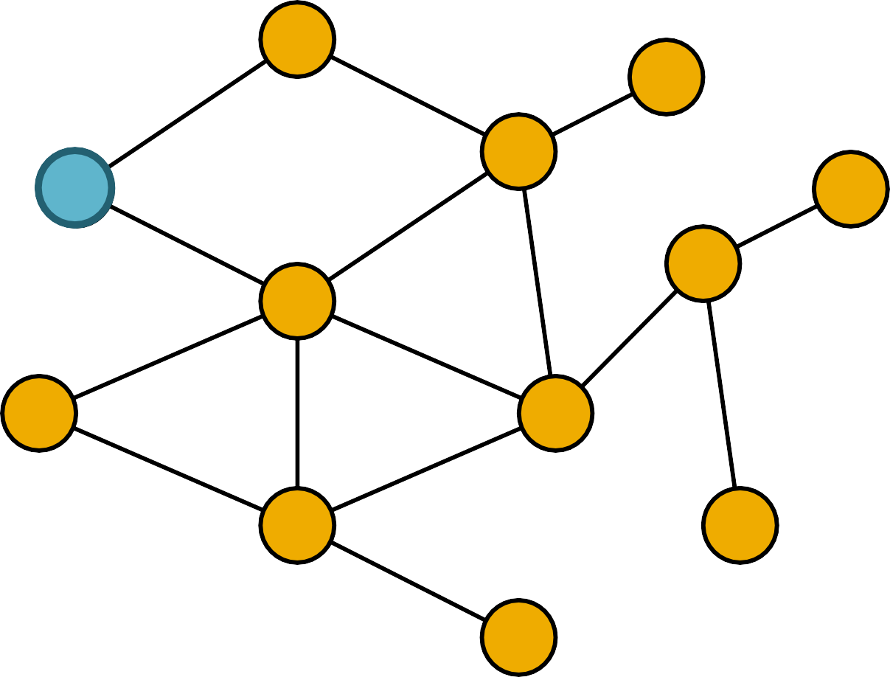
Contagions spread through
the network like epidemics
5/30/2014
Jure Leskovec, Stanford University
6

Slide 8
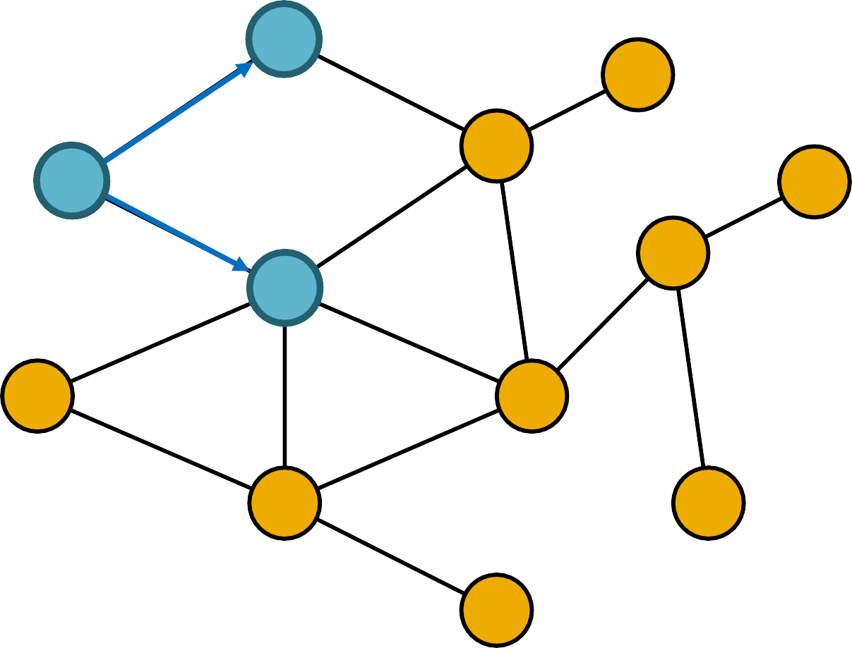
Contagions spread through
the network like epidemics
5/30/2014
Jure Leskovec, Stanford University
6

Slide 9
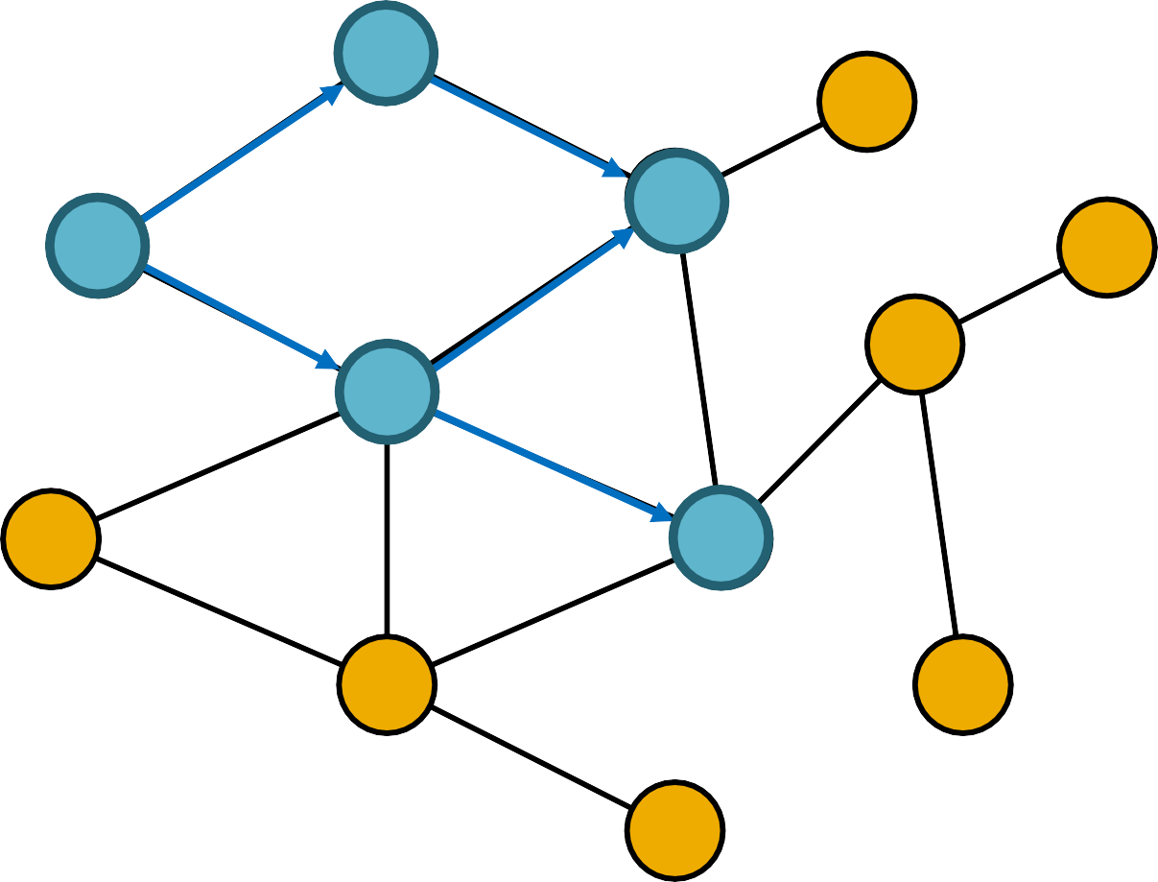
Contagions spread through
the network like epidemics
5/30/2014
Jure Leskovec, Stanford University
6

Slide 10
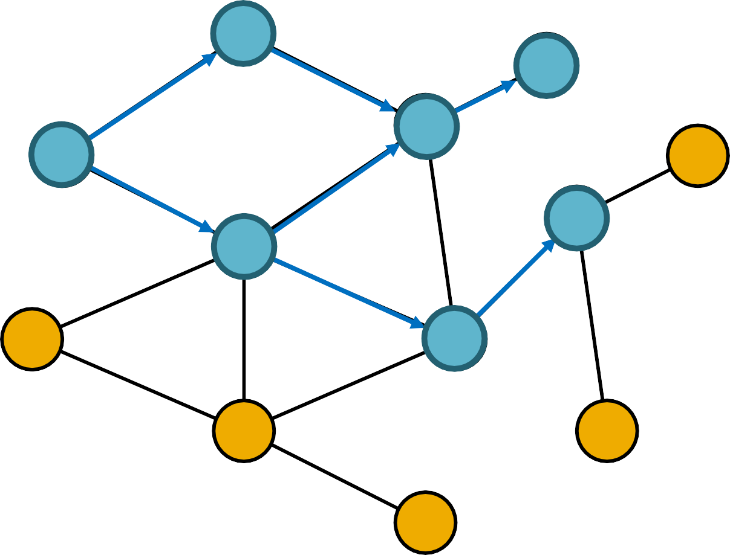
Contagions spread through
the network like epidemics
5/30/2014
Jure Leskovec, Stanford University
6

Slide 11
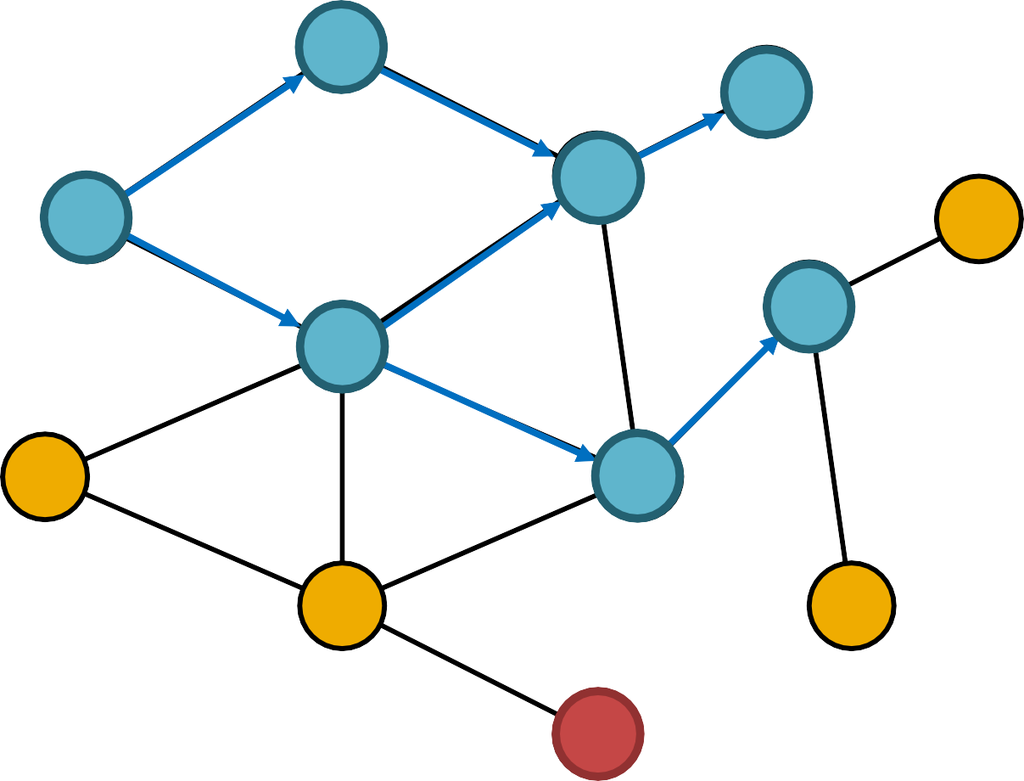
Contagions spread through
the network like epidemics
5/30/2014
Jure Leskovec, Stanford University
6

Slide 12
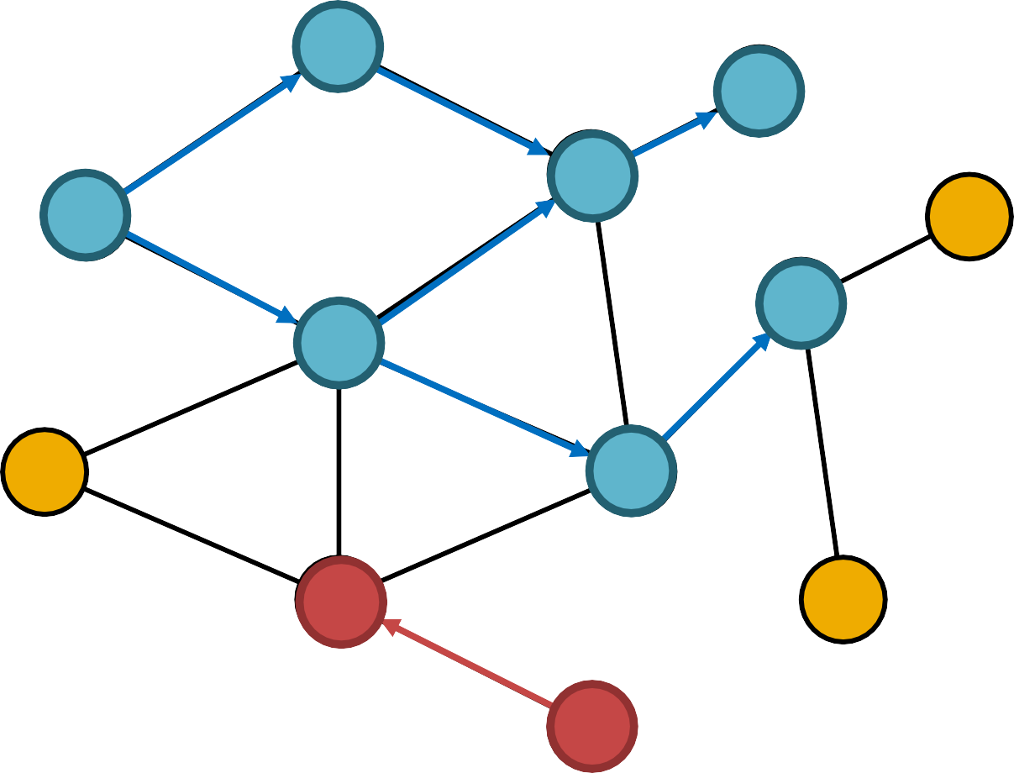
Contagions spread through
the network like epidemics
5/30/2014
Jure Leskovec, Stanford University
6

Slide 13
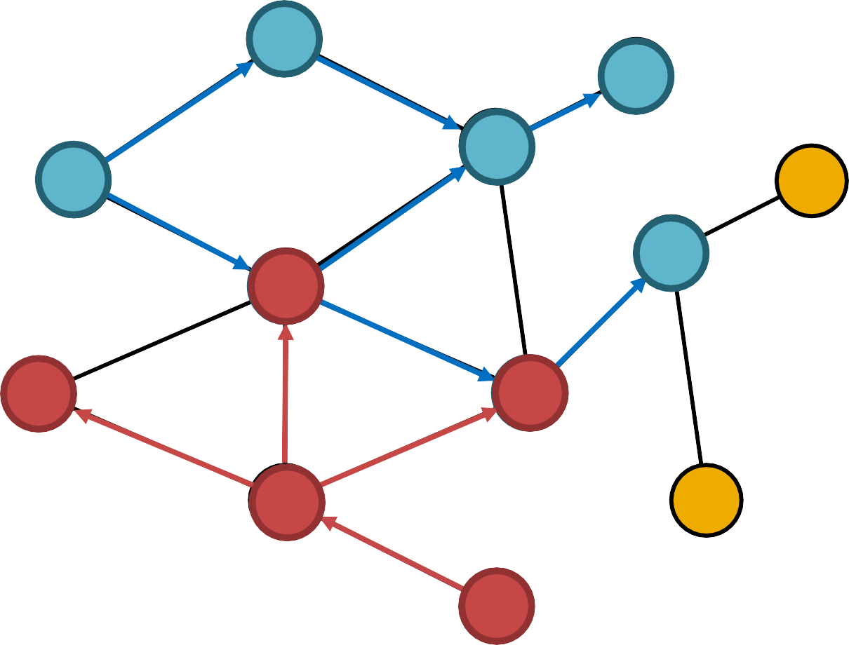
Contagions spread through
the network like epidemics
5/30/2014
Jure Leskovec, Stanford University
6

Slide 14
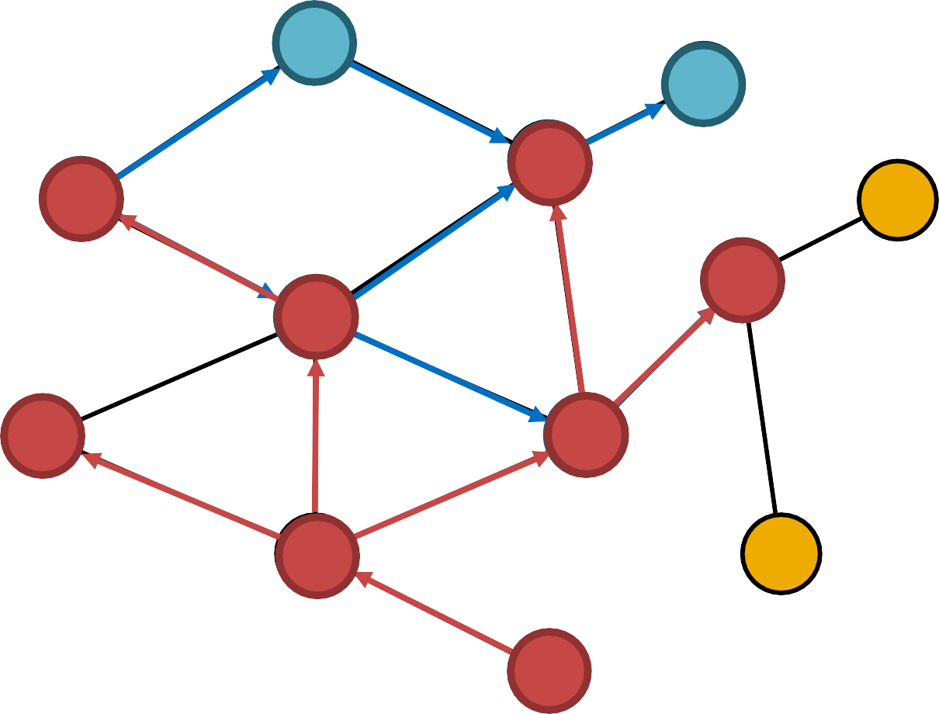
Contagions spread through
the network like epidemics
5/30/2014
Jure Leskovec, Stanford University
6

Slide 15
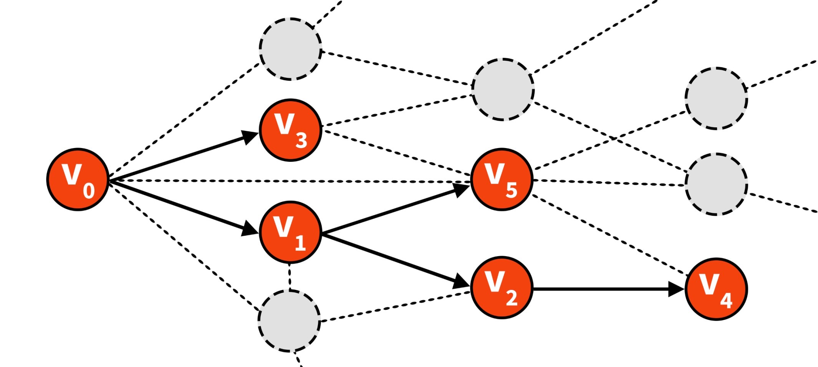
5/30/2014
Jure Leskovec, Stanford University

Slide 16
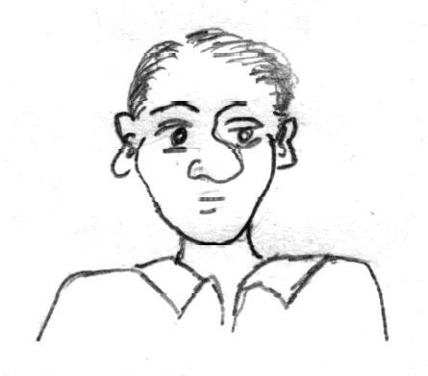
People send and receive product
recommendations, purchase products
▪
▪
▪
5/30/2014
Jure Leskovec, Stanford University
8
Notes:
Should probably skip as well – no need to stress on it

Slide 17

People send and receive product
recommendations, purchase products
▪
▪
▪
5/30/2014
Jure Leskovec, Stanford University
8

Slide 18

People send and receive product
recommendations, purchase products
▪
▪
▪
5/30/2014
Jure Leskovec, Stanford University
8

Slide 19
People send and receive product
recommendations, purchase products
▪
▪
▪
5/30/2014
Jure Leskovec, Stanford University
8

Slide 20

People send and receive product
recommendations, purchase products
▪
▪
▪
5/30/2014
Jure Leskovec, Stanford University
8

Slide 21
People send and receive product
recommendations, purchase products
Large online retailer: Jun ‘01 - May ‘03
16M recommendations on 500k products
4M customers
5/30/2014
Jure Leskovec, Stanford University
8

Slide 22
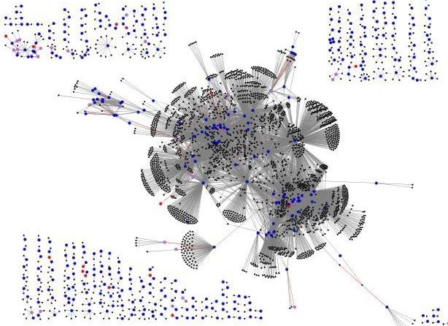
Purchase following a recommendation
Customer recommending
a product
Customer not buying a recommended product
5/30/2014
Jure Leskovec, Stanford University
9

Slide 23










As users of social media sites
(re)share information
big cascades form
5/30/2014
Jure Leskovec, Stanford University
10
Notes:
Start from here maybe – 1st slide should be

Slide 24
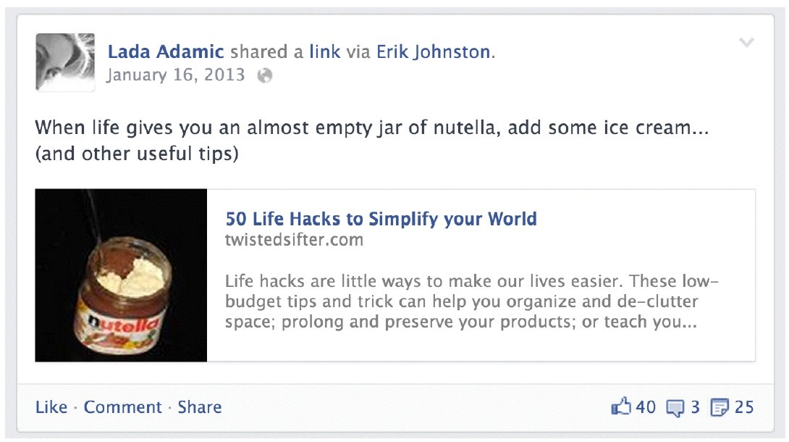
5/30/2014
Jure Leskovec, Stanford University

Slide 25
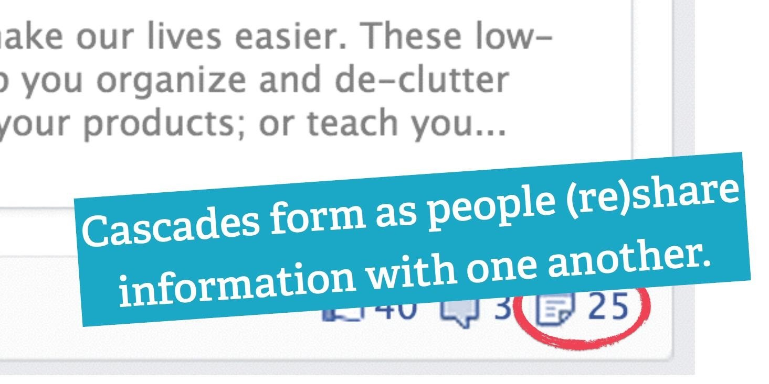
5/30/2014
Jure Leskovec, Stanford University

Slide 26
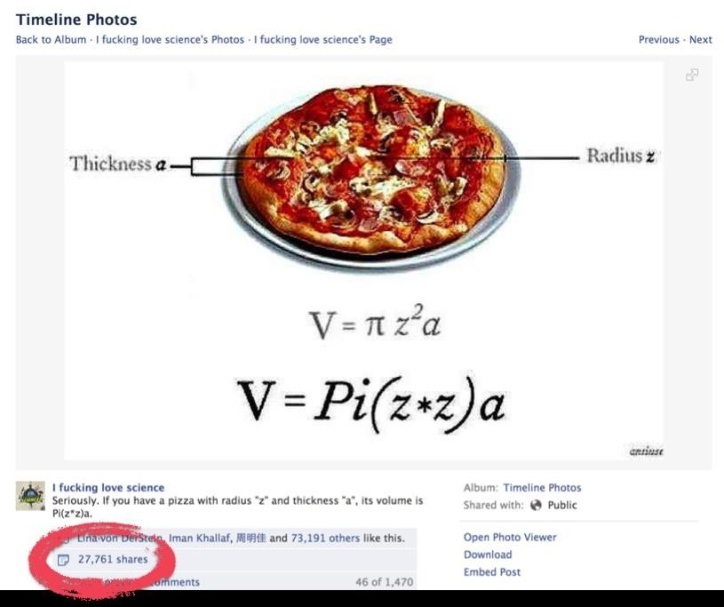
5/30/2014
Jure Leskovec, Stanford University

Slide 27
How many people are using a particular hashtag?
Ma, Z., Sun, A., & Cong, G. (2013). On predicting the popularity of newly emerging hashtags in Twitter
Will a tweet get retweeted?
Petrovic, S., Osborne, M., & Lavrenko, V. (2011). RT to Win! Predicting Message Propagation in Twitter
How does a large photo reshare cascade spread?
Dow, P. A., Adamic, L. A., & Friggeri, A. (2013). The Anatomy of Large
Facebook Cascades
How will a cascade grow in the future?
5/30/2014
Jure Leskovec, Stanford University

Slide 28
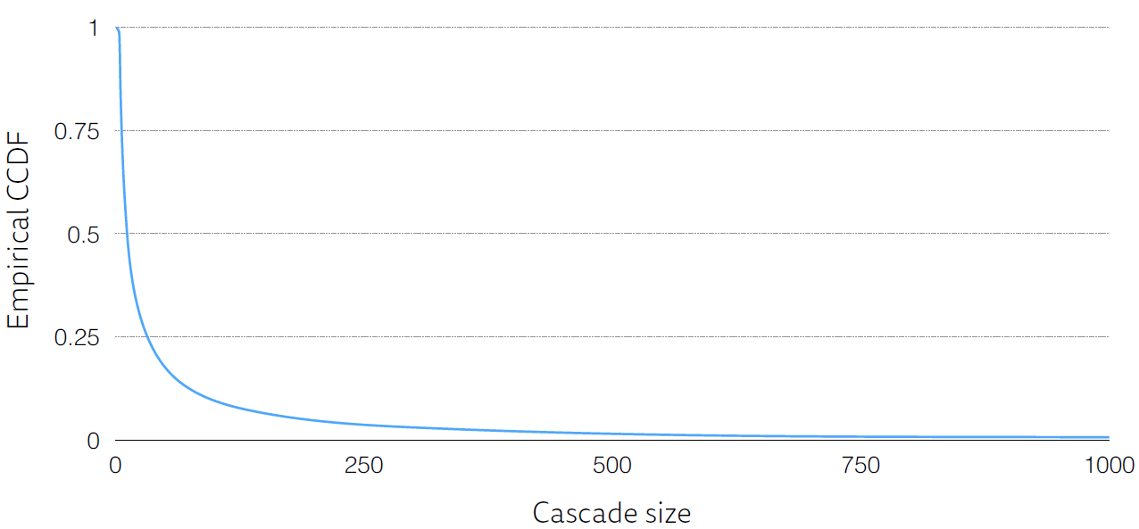
Large cascades are extremely rare
5/30/2014
Jure Leskovec, Stanford University

Slide 29
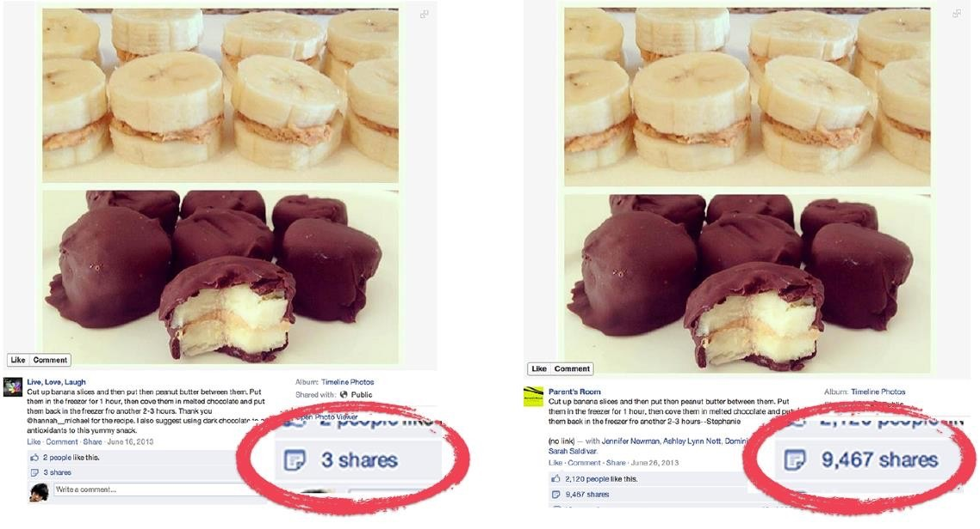
Same content, very different popularity
5/30/2014
Jure Leskovec, Stanford University

Slide 30

Increasing the strength of social influence increases both inequality
and unpredictability of success.
Salganik, M. J., Dodds, P. S., & Watts, D. J. (2006). Experimental study of inequality and unpredictability in an artificial cultural market.
5/30/2014
Jure Leskovec, Stanford University

Slide 31

Can cascades be predicted? [WWW ‘14]
Using complete Facebook data, can we predict which photos will get reshared a lot?
Can cascades be created? [ICWSM ‘13]
Can we create machine generated
submissions that get lots of activity (likes)?
5/30/2014
Jure Leskovec, Stanford University

Slide 32
Cascades are predictable!
(*solution: cascade growth prediction problem)
5/30/2014
Jure Leskovec, Stanford University

Slide 33
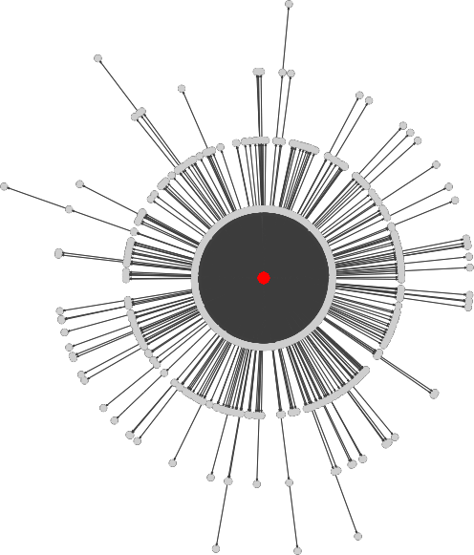
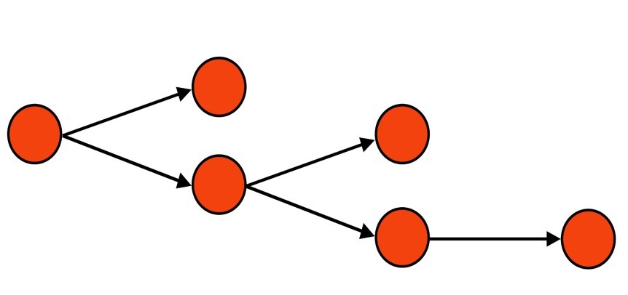

?
How to formulate the
prediction problem?
5/30/2014
Jure Leskovec, Stanford University
20

Slide 34
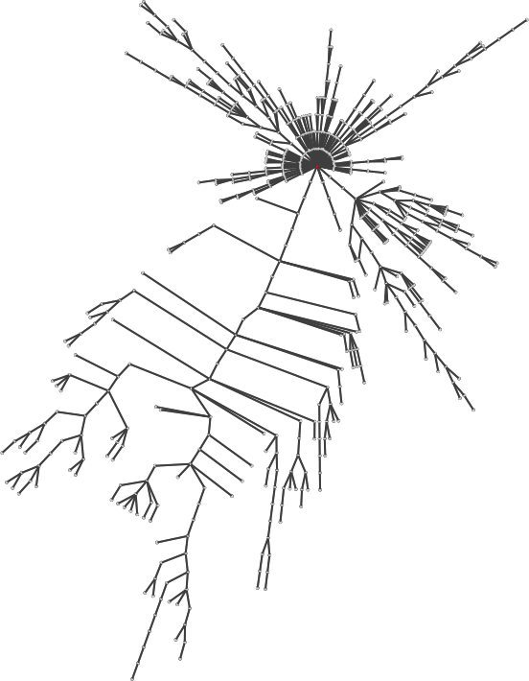
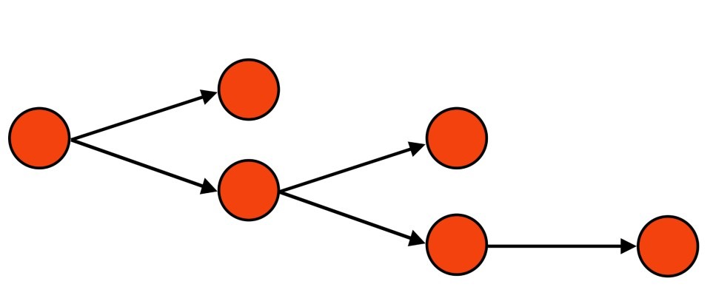

Predict whether a cascade will
get >k reshares?
?
5/30/2014
Jure Leskovec, Stanford University
21

Slide 35


Predict whether a cascade will
get >k reshares?
?
5/30/2014
Jure Leskovec, Stanford University
21

Slide 36
Predict the exact number of nodes
in a cascade
?
5/30/2014
Jure Leskovec, Stanford University
22

Slide 37

Predict the exact number of nodes
in a cascade
?
5/30/2014
Jure Leskovec, Stanford University
22

Slide 38
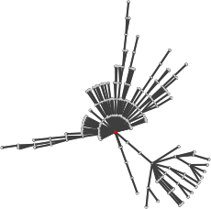
Only look at cascades with a minimum number of reshares and predict future growth
?
5/30/2014
Jure Leskovec, Stanford University
23

Slide 39

Only look at cascades with a minimum number of reshares and predict future growth
?
5/30/2014
Jure Leskovec, Stanford University
23

Slide 40
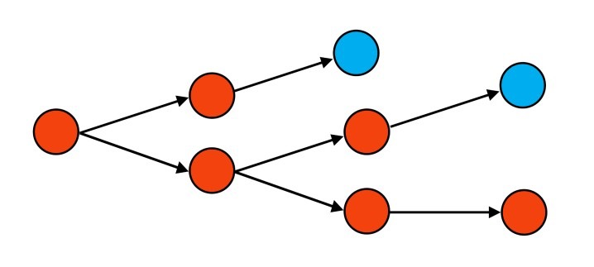

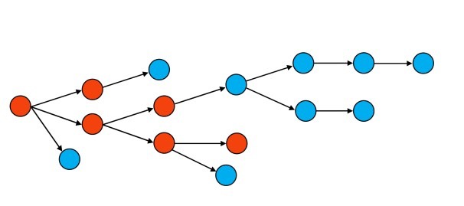
Will a cascade reach the median
size?
?
less than the median f(k)
?
k reshares
more than the
median f(k)
For cascades of size ≥ 𝒌 let the
𝒇(𝒌) be their median final size
5/30/2014
Jure Leskovec, Stanford University

Slide 41
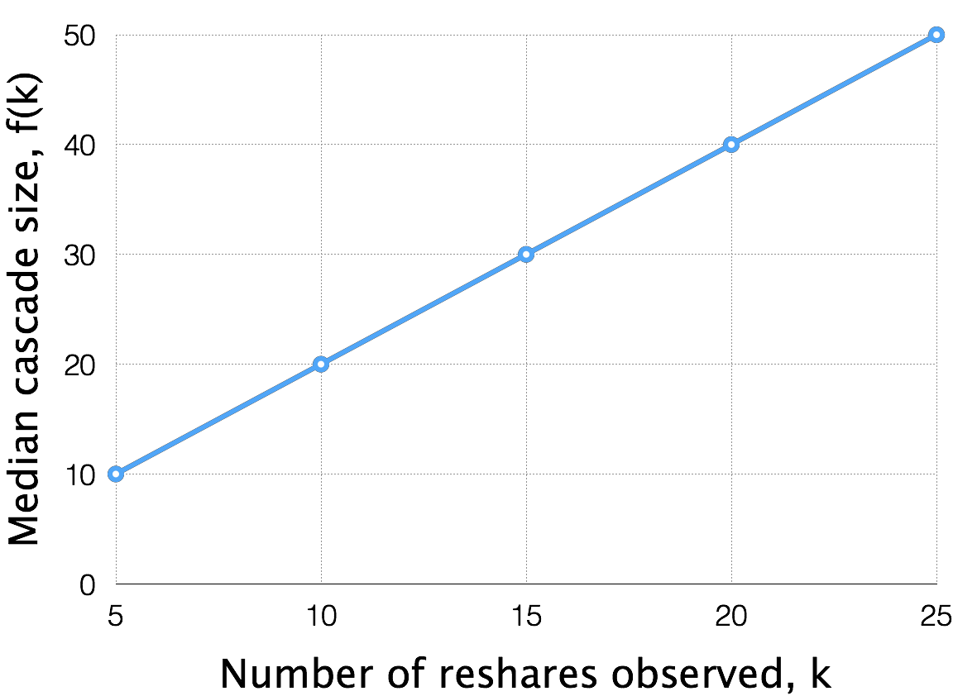
5/30/2014
Jure Leskovec, Stanford University

Slide 42



Will a cascade double in size?
?
≤2k reshares = f(k)
?
>2k reshares = f(k)
k reshares
5/30/2014
Jure Leskovec, Stanford University

Slide 43


Given that a cascade has obtained k reshares, will it grow beyond the median size f(k)=2k?
5/30/2014
Jure Leskovec, Stanford University
27

Slide 44


Given that a cascade has obtained k reshares, will it grow beyond the median size f(k)=2k?
5/30/2014
Jure Leskovec, Stanford University
27

Slide 45




We use anonymized Facebook photo resharing data from June 2013 to reconstruct reshare cascades using click, impression, and friend/follower data
Using features of the cascade,
we evaluate the performance of a classifier
5/30/2014
Jure Leskovec, Stanford University

Slide 46
Content
(e.g. has overlaid text)
User
(e.g. follower count)
Structural
(e.g. proximity to root in G)
Temporal
(e.g. time between reshares)
5/30/2014
Jure Leskovec, Stanford University

Slide 47
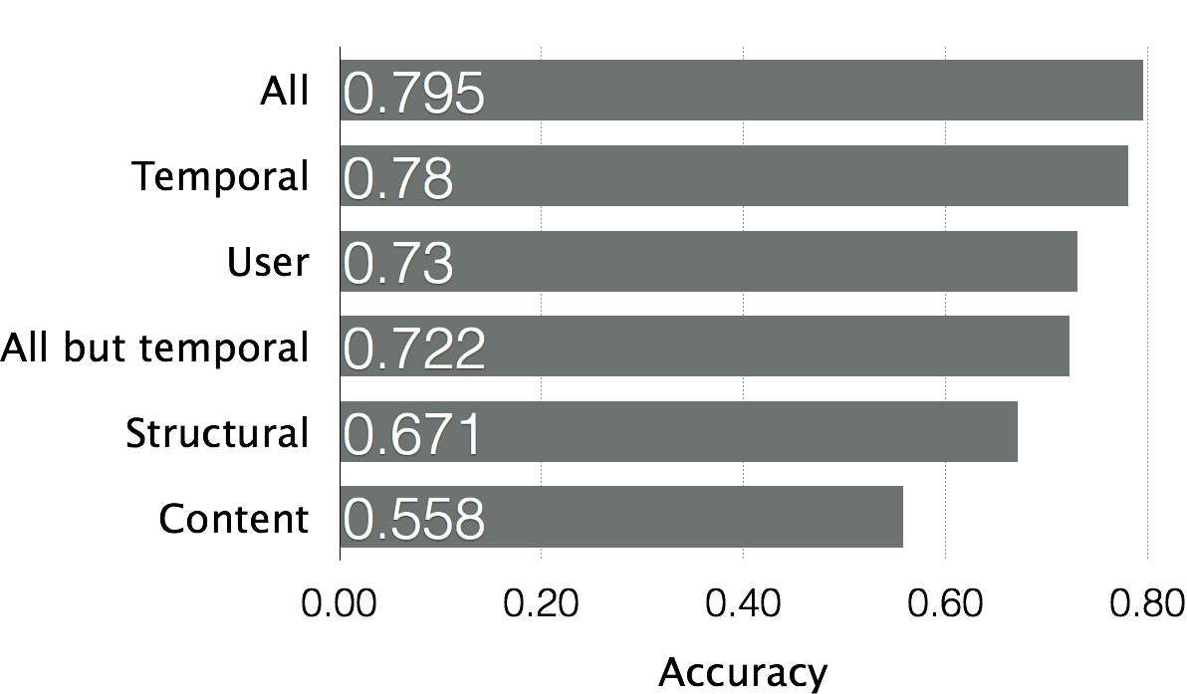
All but temporal
Will a cascade double (k=5)?
5/30/2014
Jure Leskovec, Stanford University
30

Slide 48
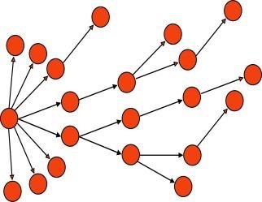
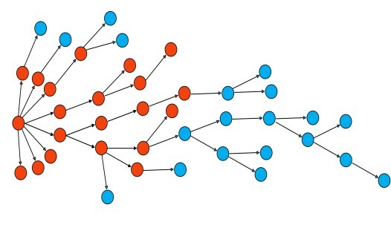

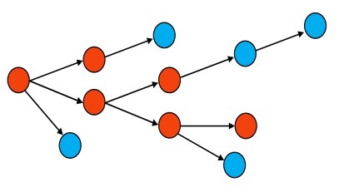
How does predictability change
with k?
vs.
5 reshares
> 10 reshares?
20 reshares
> 40 reshares?
▪
▪
▪
5/30/2014
Jure Leskovec, Stanford University
31

Slide 49

How does predictability change
with k?
vs.
5 reshares > 10 reshares? 20 reshares > 40 reshares?
Two opposing arguments:
Easy: see more of the cascade
Hard: predict farther into the future
5/30/2014
Jure Leskovec, Stanford University
31

Slide 50
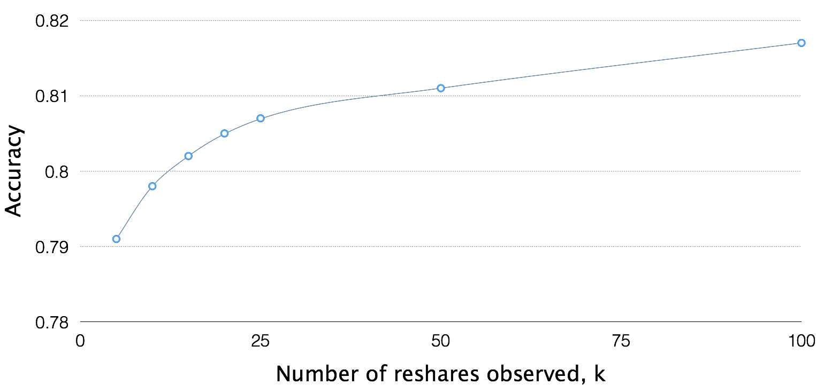
5/30/2014
Jure Leskovec, Stanford University

Slide 51
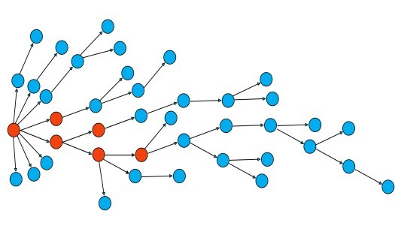



Fix the minimum cascade size R ≥ k
How does predictability change with k?
vs.
5 reshares >40 reshares? 20 reshares >40 reshares?
Is there a “sweet” spot when we have enough information to be able to predict?
5/30/2014
Jure Leskovec, Stanford University

Slide 52
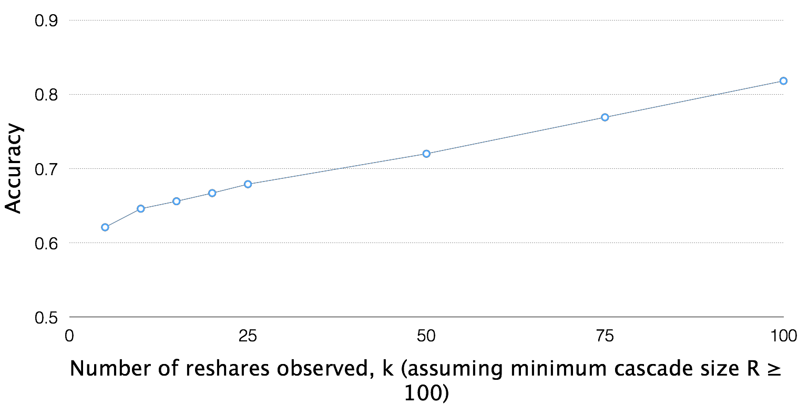
5/30/2014
Jure Leskovec, Stanford University

Slide 53
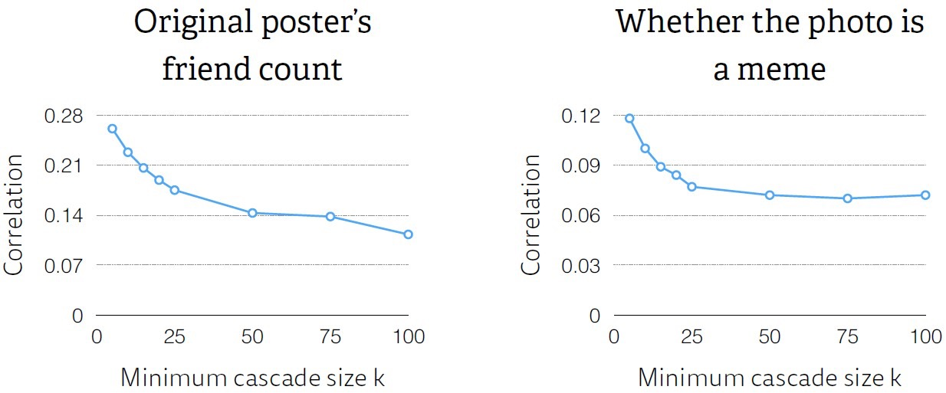
The original post (and poster) get
less important with increasing k
5/30/2014
Jure Leskovec, Stanford University

Slide 54
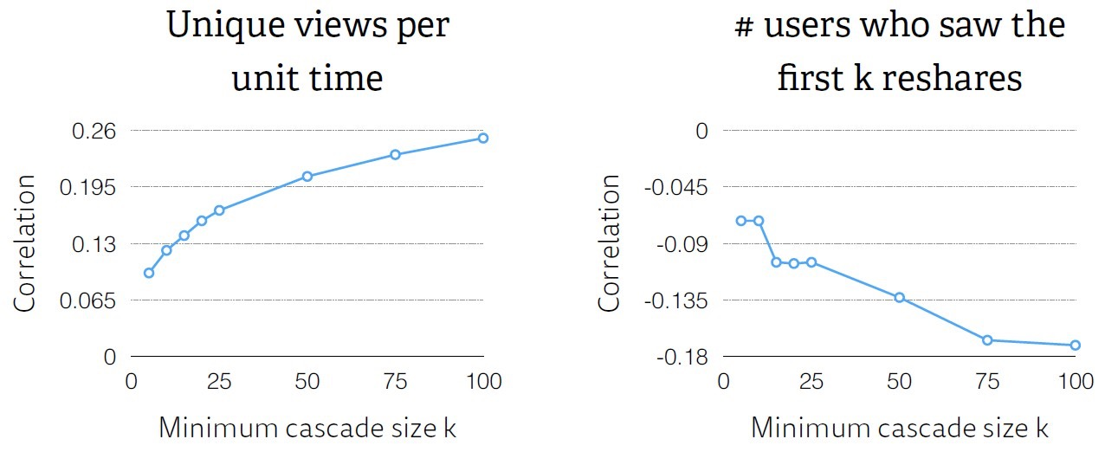
Successful cascades get many views quickly, and achieve high conversion rates
5/30/2014
Jure Leskovec, Stanford University

Slide 55
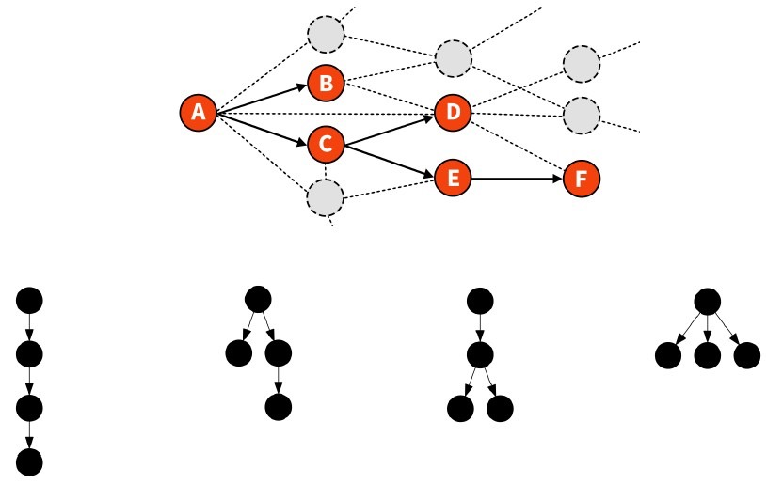
5/30/2014
Jure Leskovec, Stanford University

Slide 56
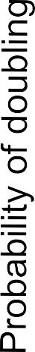
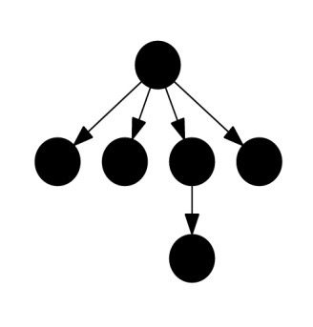
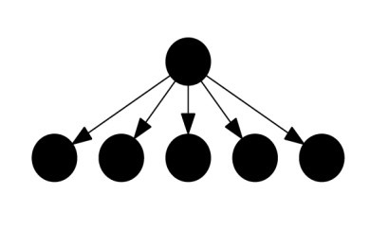

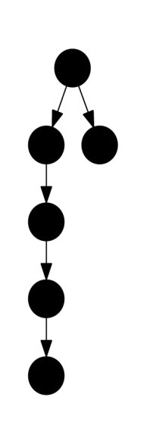
…
5/30/2014
Jure Leskovec, Stanford University

Slide 57
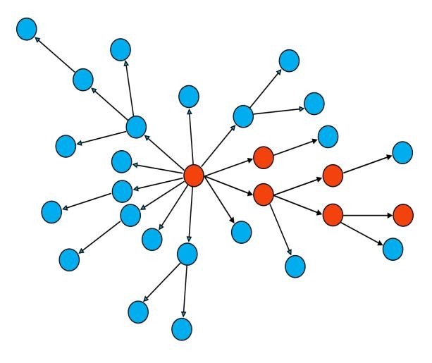
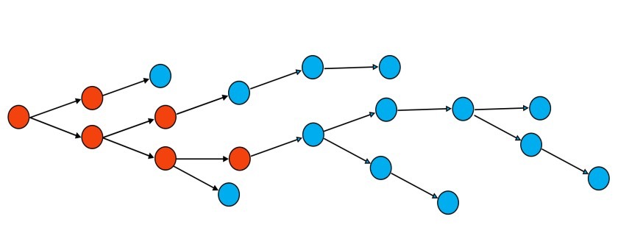
Predictability of cascade structure:
?
?
5/30/2014
Jure Leskovec, Stanford University

Slide 58

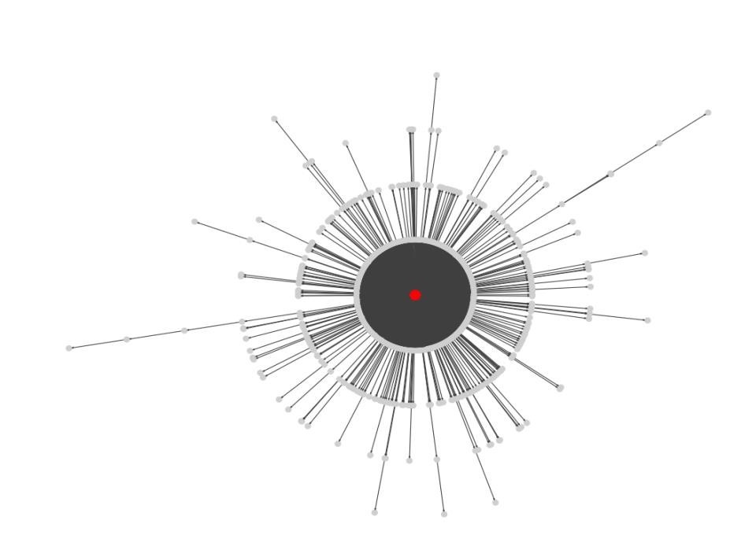
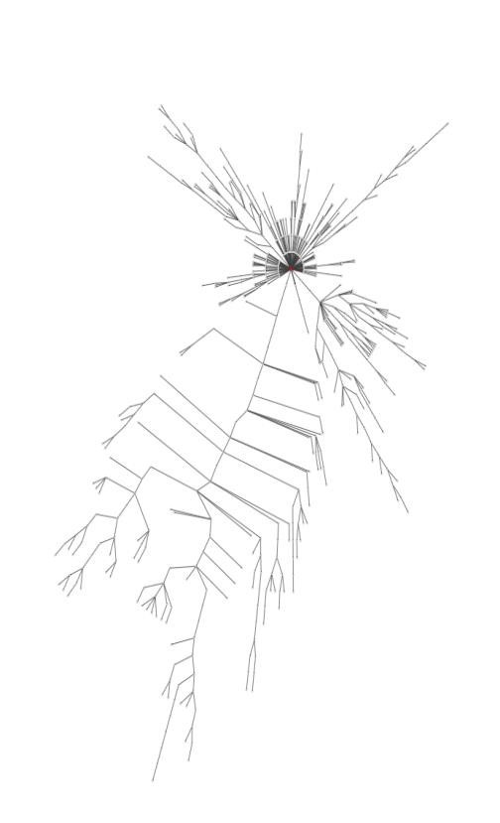
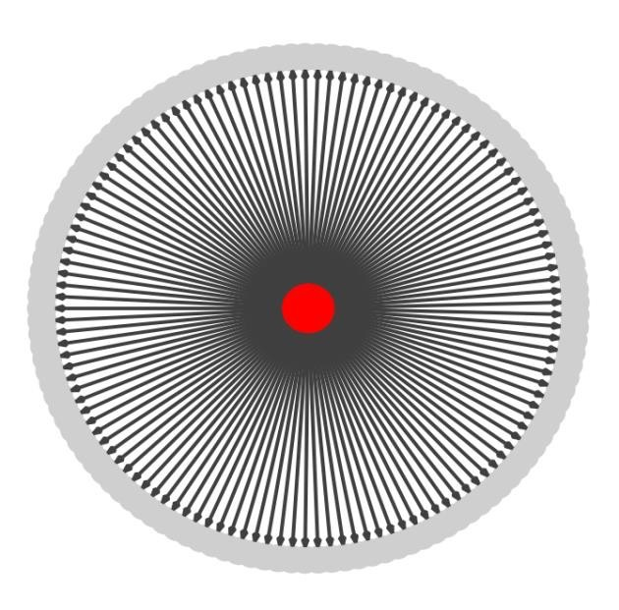
Wiener index: Mean all-pairs shortest
path distance in a cascade
d = 1.98 d = 2.47 d = 14.4
Anderson, A., Goel, S., Hofman, J. & Watts, D. J. The structural virality of online diffusion.
5/30/2014
Jure Leskovec, Stanford University
40

Slide 59
Will a cascade have structural
virality above the median?
5/30/2014
Jure Leskovec, Stanford University
41

Slide 60



Will a cascade have structural
virality above the median?
5/30/2014
Jure Leskovec, Stanford University
41

Slide 61
Increasing the strength of social influence increases both inequality
and unpredictability of
success.
Salganik, M. J., Dodds, P. S., & Watts, D. J. (2006). Experimental study of inequality and unpredictability in an artificial cultural market.
5/30/2014
Jure Leskovec, Stanford University

Slide 62
5/30/2014
Jure Leskovec, Stanford University

Slide 63
Can we differentiate cascades of the same content?
5/30/2014
Jure Leskovec, Stanford University

Slide 64

Consider identical photos uploaded to Facebook, generating 983 clusters, 38k photos, 13m reshares
For each cluster, we select ten random cascades, and predict which was the largest
Random guessing: 10% accuracy
5/30/2014
Jure Leskovec, Stanford University

Slide 65
Can we predict the largest of 10 random chosen cascades of the identical image?
5/30/2014
Jure Leskovec, Stanford University
46

Slide 66


Can we predict the largest of 10 random chosen cascades of the identical image?
5/30/2014
Jure Leskovec, Stanford University
46

Slide 67
So…how do I make my
posts go “viral”?
5/30/2014
Jure Leskovec, Stanford University

Slide 68
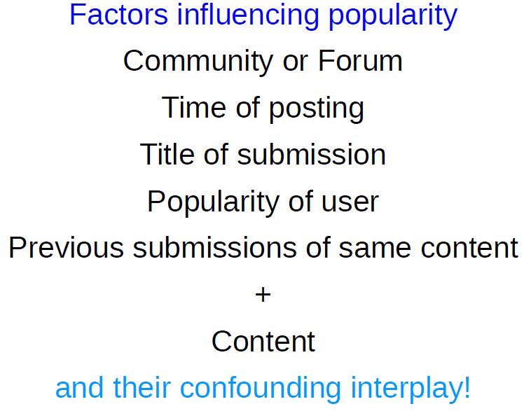
Given a piece of content, can we
maximize probability of its success?
5/30/2014
Jure Leskovec, Stanford University

Slide 69

Cascades are predictable
The cascade growth prediction problem, allows us to accurately predict the future growth of a cascade, even as it continues to grow in size
Cascades can be engineered
(to a large extent)
5/30/2014
Jure Leskovec, Stanford University

Slide 70
What have we learned about “viral”
posts?
Favor memes (i.e. post popular content)
Have lots of followers (i.e. be popular)
Know what your friends like, and what your friends’ friends like (i.e. be a marketing guru)
Post at the right time
5/30/2014
Jure Leskovec, Stanford University

Slide 71
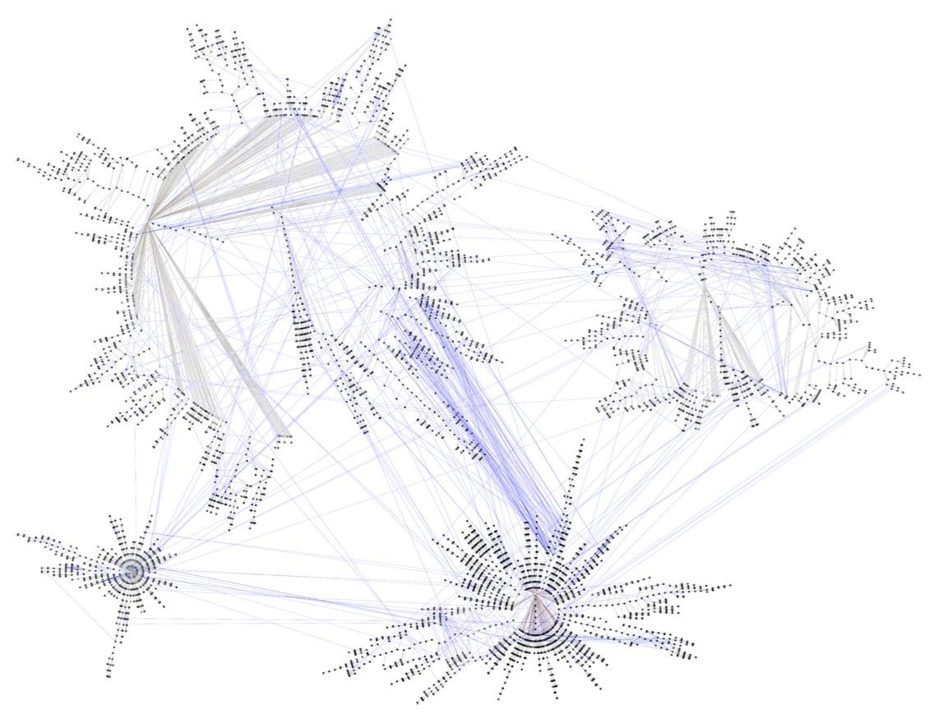
5/30/2014
Jure Leskovec, Stanford University

Slide 72
Can this analysis help identify dynamics
of polarization?
Connections to mutation of information:
How does attitude and sentiment change in
different parts of the network?
How does information change in different parts of the network?
5/30/2014
Jure Leskovec, Stanford University

Slide 73

Messages spreading through network require new ways of thinking about information dynamics and consumption
Feedback effects in networks:
The feedback from using your social connections
Some links are strengthened, others created:
Something that’s been going on for millennia
The feedback from media that let you observe your place in the social network
A new and uncontrolled experiment
5/30/2014
Jure Leskovec, Stanford University

Slide 74



Slide 75

Can Cascades be Predicted? by J. Cheng, L. Adamic, A. Dow,
J. Kleinberg, J. Leskovec. ACM International Conference on
World Wide Web (WWW), 2014.
What’s in a name? Understanding the Interplay between Titles, Content, and Communities in Social Media by H. Lakkaraju, J. McAuley, J. Leskovec. AAAI International Conference on Weblogs and Social Media (ICWSM), 2013.
The Dynamics of Viral Marketing by J. Leskovec, L. Adamic,
B. Huberman. ACM Transactions on the Web (TWEB), 1(1),
2007.
The Bursty Dynamics of the Twitter Information Network by S. Myers, J. Leskovec. ACM International Conference on World Wide Web (WWW), 2014.
5/30/2014
Jure Leskovec, Stanford University
70

